Slide 1

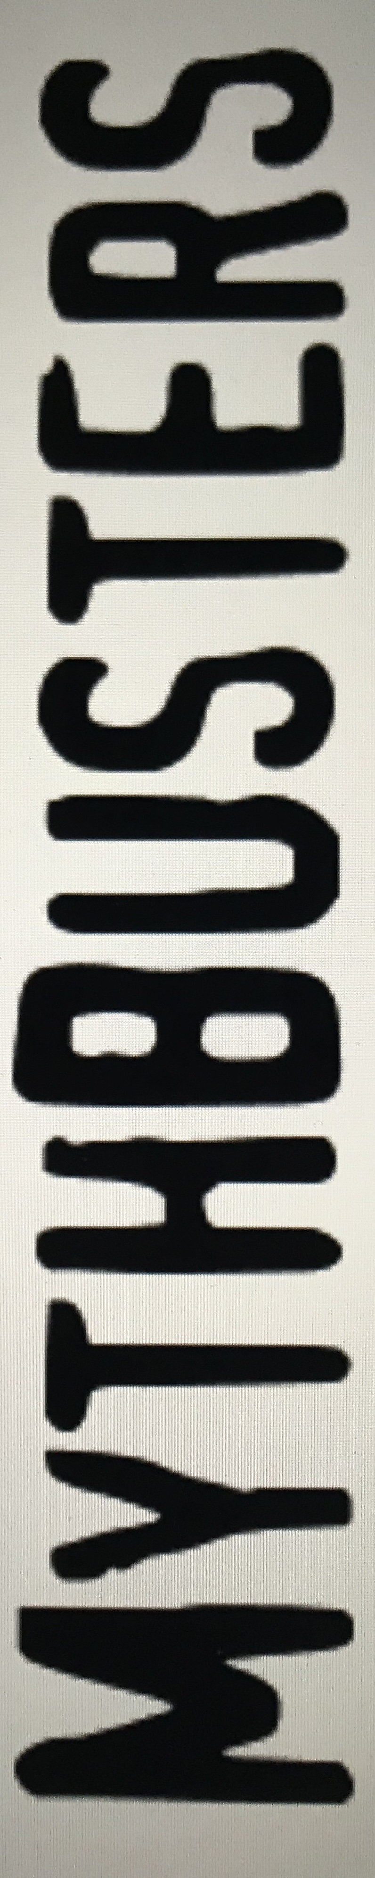
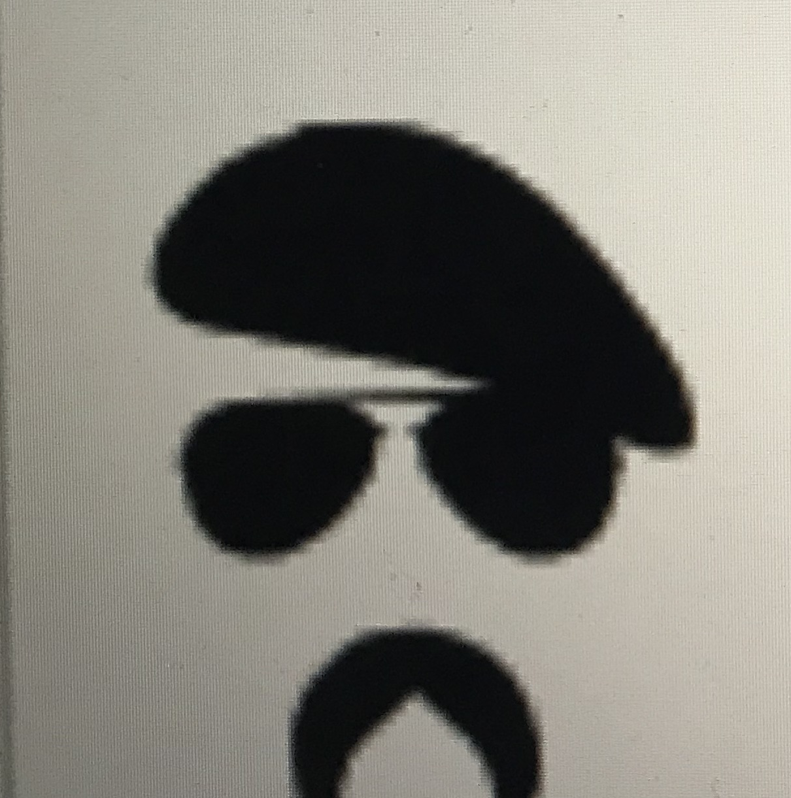
Conformis Lab, Dallas 2018
Matt barber, md

Slide 2
Myth #111
The Femoral and Tibial implants are NOT made custom for each patient… only the jigs are custom

Slide 3
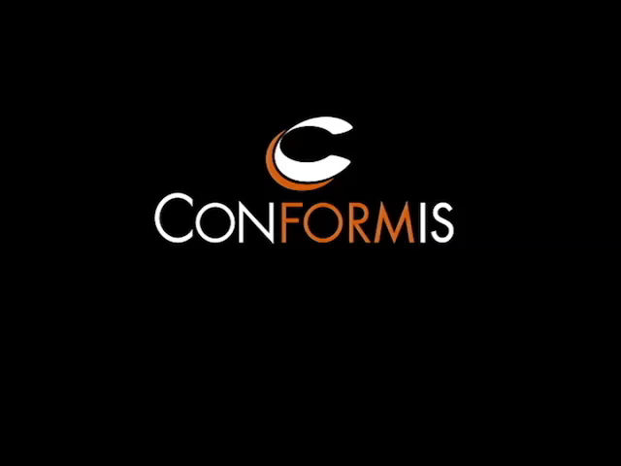

Myth #1

Slide 4
Myth #2
Conformis does not have any clinical data

Slide 5
Myth #2
Published Peer Reviewed Manuscripts
  Kurtz – Bone preservation, iTotal – Reconstructive Review
  Patil – Kinematics, iTotal– The Knee
  Ivie/Bal – Alignment accuracy, iTotal – J Arthroplasty
  Schwartzkopf – Surgical and Functional Outcomes, iTotal – Orthopedic J Sports Med.
  Zeller/Komistek – Kinematics, iTotal – J Arthroplasty
  Culler/Martin – Economics/Adverse Events, iTotal – Arthroplasty Today
  Levengood – Alignment accuracy, iTotal – J Knee Surgery
  Schroeder/Martin – Tibial fit & rotation – J Knee Surgery
  Carpenter/Barnes – Tibial Coverage, iUni – J Arthroplasty
  Demange – Outcomes/survivorship, iUni (lateral) – Int. Orthopedics
  Steinert – Outcomes/Early survivorship, iUni – Operative Orthop & Traumatology
  Wang/Rolston – Function/Biomechanics, iDuo – Int. Orthopedics
  Steinert – Outcomes/Early survivorship, iDuo – Operative Orthop & Traumatology
  Palumbo – Design Rationale Patient Specific TKA, iTotal – Techniques in Knee Surgery
  Schwechter – Design Rationale for Customized TKA, iTotal – Current Reviews in Muscul. Medicine
  Sinha – Customized TKR Efficiency in the OR, iTotal – Current Reviews in Muscul. Medicine
  Jemmett – Outcomes/Early survivorship, iDuo – Reconstructive Review
  Nunley – Tibial Slope, iUni – J Arthroplasty
  Koeck – Alignment accuracy, iUni – The Knee
  Fitz – Design Rationale Patient Specific Implants, iUni – J of Bone Joint Surgery
Notes:
General slide to let attendees know we have a wide variety of clinical data, and if there is a particular area that interests them to let us know and we can provide

Slide 6
Myth #3
Conformis is not any better than a standard OTS implant
Notes:
Decided to start with Kinematics and then go touch on patient satisfaction

Slide 7
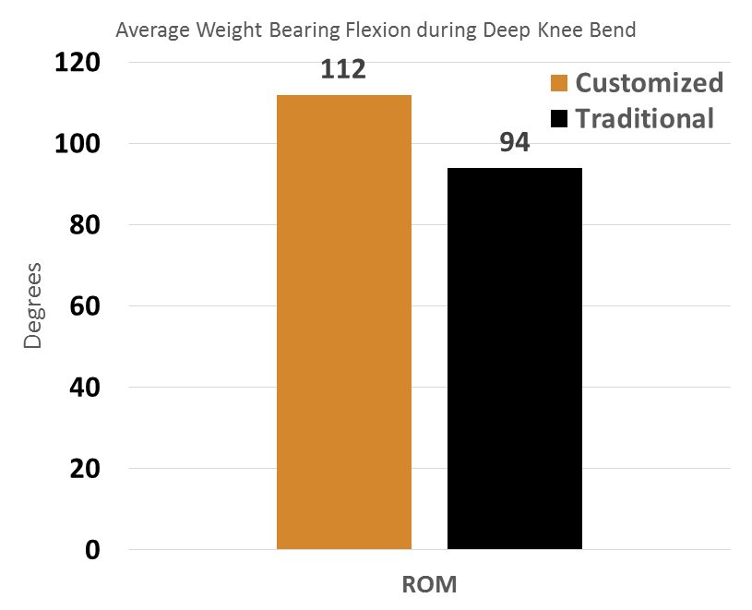
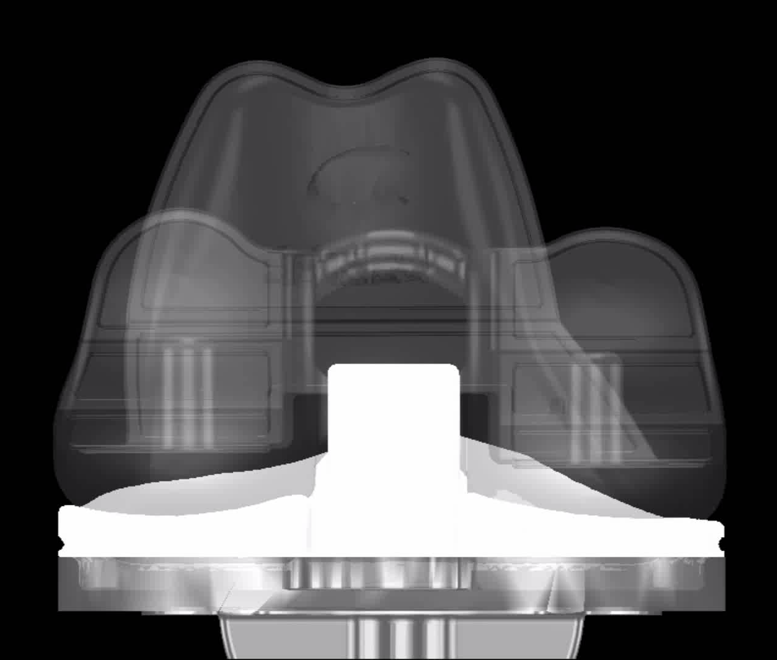
Myth #3
iTotal PS: Better Kinematics vs OTS TKR
  iTotal PS:
  Significantly higher range of motion vs OTS TKR
  Significantly higher rollback on the lateral and medial condyle during flexion
  Centralized contact on the post

Slide 8
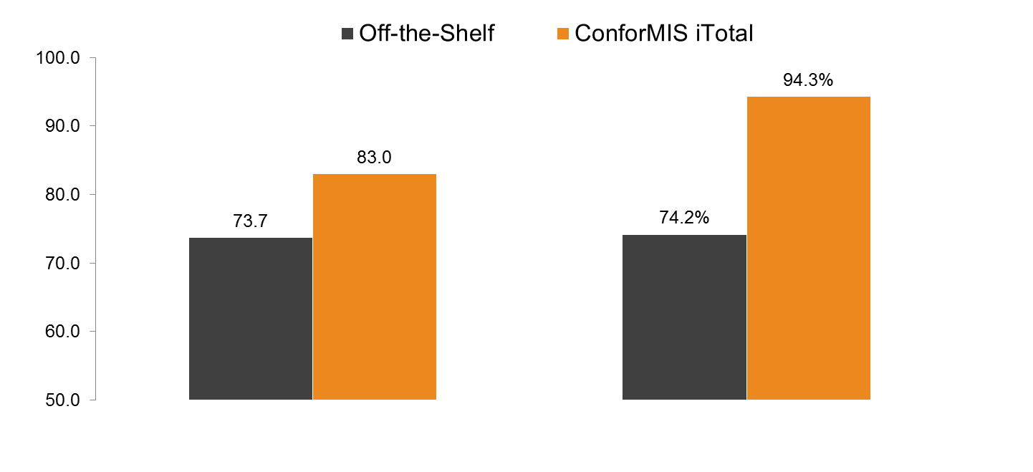
Myth #3
iTotal: Patient satisfaction
Patient Reported Outcomes – 1 Year Follow-up
70 patients (35 iTotal CR, 35 off-the-shelf), matched pair analysis (age, sex, deformity)

Slide 9
Myth #4
Higher than average rate of stiffness requiring manipulation

Slide 10
Myth #4
Prospective multicenter Study (360 Patients/9 centers)
TKA with a patient-specific implant resulted in a MUA rate of 3.05%
  Consistent with the current literature reporting rates 1.5-6%

Slide 11
Myth #5
Conformis results in a higher revision rate than OTS TKA

Slide 12
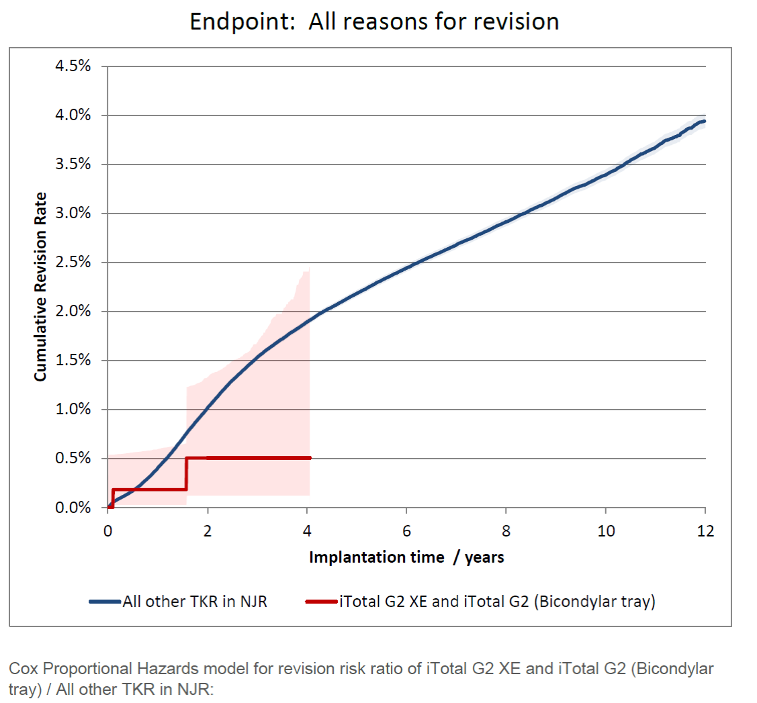
Myth #5
iTotal CR in the UK National Joint Registry
Mean Follow-up: 1.9 years (max: 5.6 years)
576 procedures at 46 centers
3 revisions reported to date
0.5% revision rate @4 years compared to 1.9% revision rate for all TKRs in the NJR.
Notes:
UK study

Slide 13
Myth #5
Prospective multicenter Study (360 Patients/9 centers)
revision rate 1.6%
  4 polyethylene exchange
    All had ROM >105° 6 months after the index procedure
  1 periprosthetic fracture
  1 metal hypersensitivity
99.2% survivorship at avg follow-up of 1.9 yrs
Notes:
Prospective Multicenter Study

Slide 14
Myth #6
Increased poly wear

Slide 15


Myth #6
70 mg/yr represents the particle wear rate below which osteolysis does not occur
High Conformity/Contact Area articular surface
State of the art polyethylene in Conventional or Highly crosslinked vitamin E stabilized
Secure insert to tray locking design
Highly finished insert pocket on tibial tray

Slide 16
Myth #7
Conformis is double the cost of an OTS implant

Slide 17
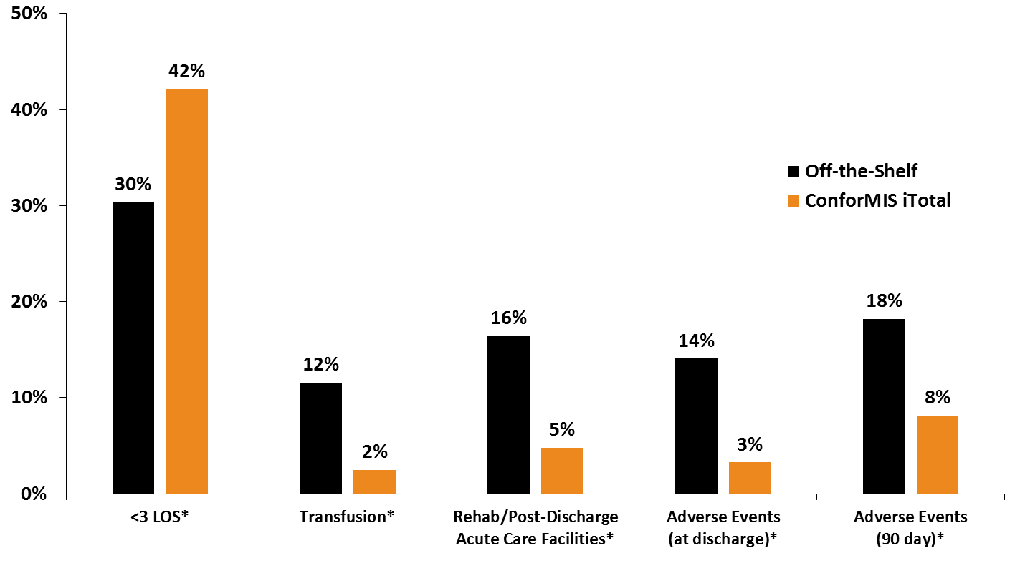
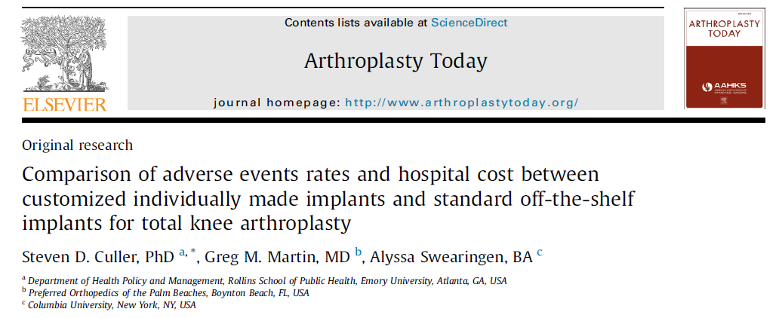
Myth #7
$900* savings for iTotal CR group for total cost
*Inclusive of CT scan cost
248 patients (126 iTotal, 122 off-the-shelf)

Slide 18
Thank you

