Slide 1
Understanding Knee Replacement Kinematics:
Will Kurtz

Slide 2
“Those who do not learn history are doomed to repeat it.”
Disclosure:
Conformis
Notes:
I am a consultant and receive royalties on Conformis products.
We are going to take a Chronological look at how today’s TKA have evolved.

Slide 3
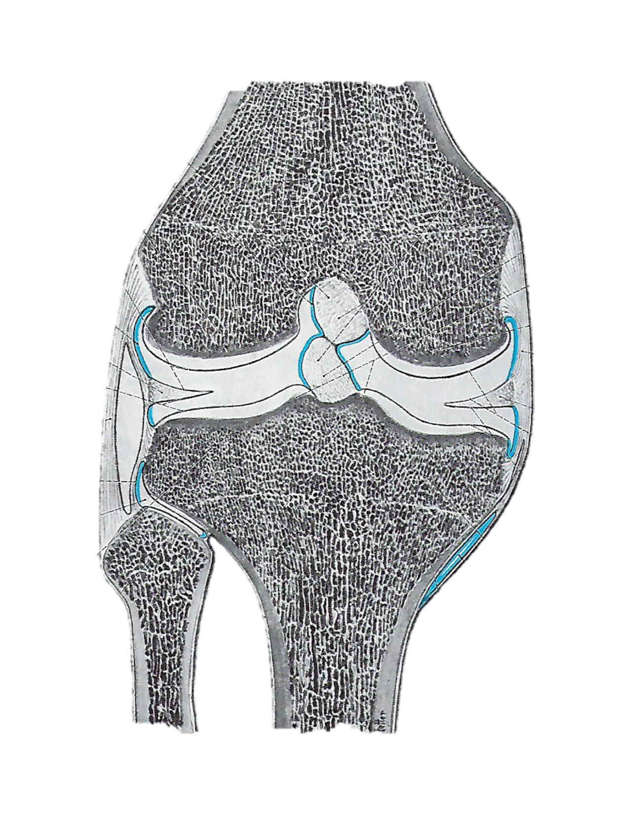
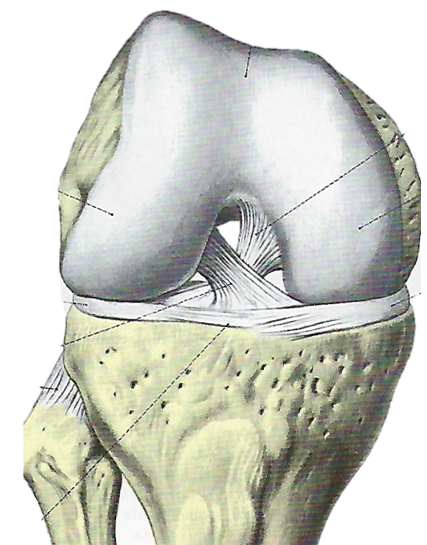
Background: Varus Joint Line
Distal femur is valgus
Proximal Tibia is varus
Extension
Flexion
Oblique or Varus Joint line
Different from Mechanical Alignment

Slide 4
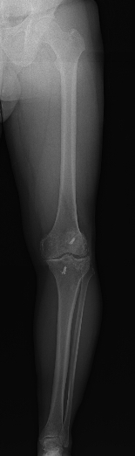
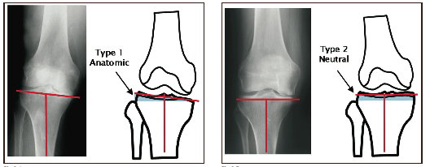


Prevalence of the Varus Joint Line
Andy Hodge
78% TKAs are type I (Varus Joint line)
Nunley Barrack
69% of knees have a varus joint line
52.5% of knees had > 3° varus joint line

Slide 5
Distal Femoral Offset in 2400 Consecutive Customized TKAs
1/3 TKAs
No
Varus Joint line
1/3 TKAs
Moderate
(2-4°)
Varus Joint line
1/3 TKAs
Severe
(4-9°)
Varus Joint line

Slide 6



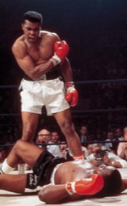
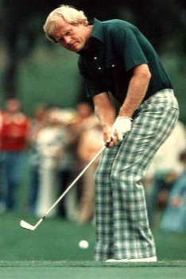
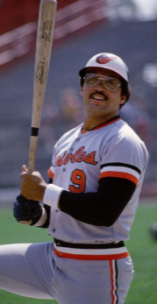
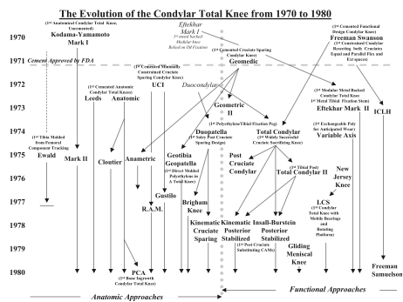
The 70’s
Notes:
And we are going to go back in time and start our journey in the 70’s
The top band was the Bee Gees with 3 of the top 20 songs –
How Deep is your Love
Night Fever
Staying Alive
The top grossing movies were
#1 Star Wars – ‘77
#2 Jaws- ’75
The best athletes were
Jack Nicholas -
Muhhham Ali -
Reggie Jackson – “Mr. October” – won 5 world series
The 70’s were the wild wild west from knee replacements. The term “Condylar Total knee” was used to describe the evolution from the IM fixated, hinged knee replacements on the 50’s and 60’s to the one-piece resurfacing femoral and tibial components that we know today.
In 1963, “high-density” polyethylene plastic was approved as a bearing surface
March 1970, the first condylar knee was implanted by Freeman at the London Hospital
In 1971, FDA's approval of methylmethacrylate for general use in the United States.
In 1973, a femoral flange covering the excursion of the patella was added;
In 1974, 3 knees were implanted with a polyethylene patellar button
During the 70’s , we begin to see the formation of 2 camps: Classical (or Functional) alignment vs. Anatomic alignment
Anatomical approach involved implants that preserved most or all of the soft tissue constraints and attempted to design fixed implant surfaces that avoided conflict with these constraints. CR, Measured Resection & restore varus joint line.
Functional approach involved attempts either to simplify knee mechanics by resecting the cruciate ligaments or to design movable joint surfaces to avoid conflict with the kinematics dictated by soft tissues. The functional approach permitted non-anatomical joint surface geometries intended to maximize surface area and reduce polyethylene stress. PS, Gap Balancing, & ignore varus joint line

Slide 7
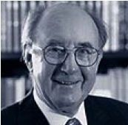
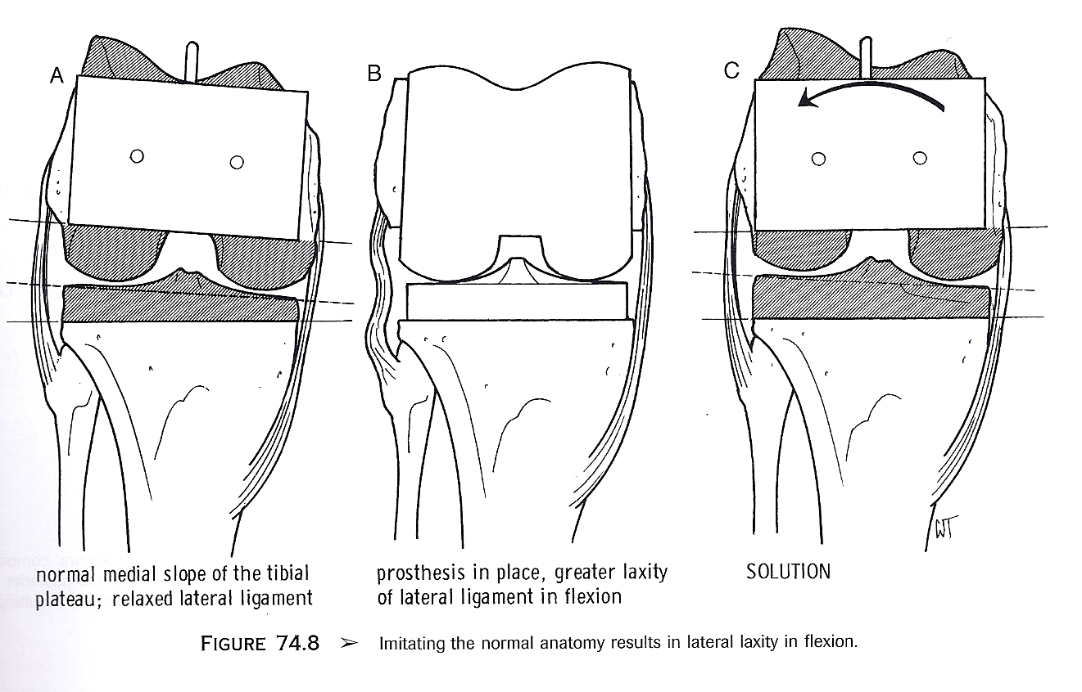
1980
2000
2018
1970
1990
2010
Classical Alignment – Gap Balancing
Perpendicular bone cuts
Remove more distal MFC
Externally Rotate femoral component
Remove more lateral tibial plateau
Remove more posterior MFC
Same Surgical technique for all patients
Altered knee kinematics

Slide 8

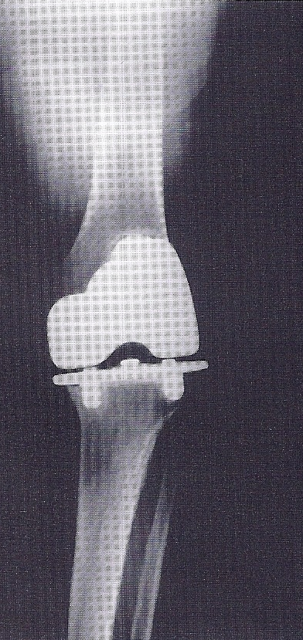
1980
2000
2018
1970
1990
2010
Anatomical Alignment – Measured Resection
Hard to measure the varus joint line
Hard to execute a patient specific surgical plan
Reproduce normal Knee Kinematics
Different technique for every patient

Slide 9
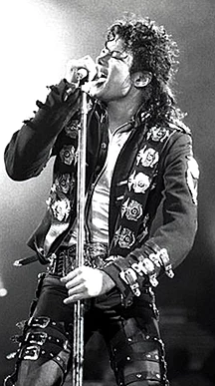





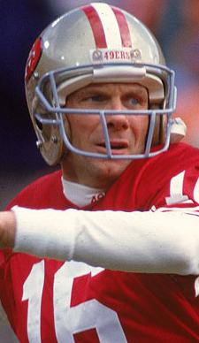
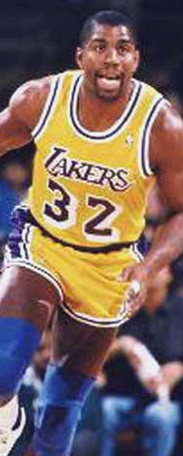
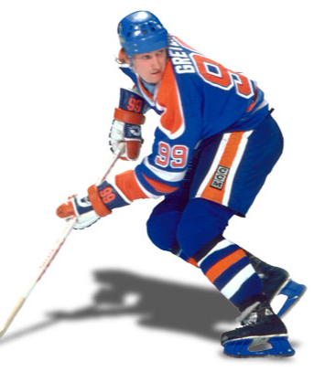
The 80’s
Notes:
The 80’s
The top artists of the 80’s were:
Michael Jackson had 9 #1 hits
Madonna had 7 #1 hits
Whitney Houston had 7 #1 hits
The top grossing movies were
#1 – E.T. ‘82
#5 Raiders of the Lost Ark ’81
#8 Back to the Future ‘85
The best athletes were
Joe Montana
Magic Johnson
Wayne Gretasky
The Anatomical approach became Measured Resection (Hungerford) and predominately CR knees – PCA implants
The functional approach (or classical alignment) became Gap Balancing (Install) and predominately PS knees – IB 1&2 => Zimmer’s NexGen, TC => Depuy’s PFC, LCS
.T.

Slide 10
Anatomic vs. Classical Debate:
1980
2000
2018
1970
1990
2010
Varus Bone Cuts
Easy to handle Deformity
Easy Surgical Technique
No measurement
Perpendicular Bone Cuts
Hard to Measure
Hard to handle Deformity
Hard to Execute
!!! Winner !!!
Varus Bone Cuts
Easy to handle big deformity
Easy surgical technique
No measurements
Perpendicular Bone Cuts
Hard to handle big deformities
Hard to Execute
Hard to Measure
Accept compromises in kinematics to improve reproducibility of the surgical technique
Accept difficulty in executing a patient specific surgical technique to improve kinematics

Slide 11




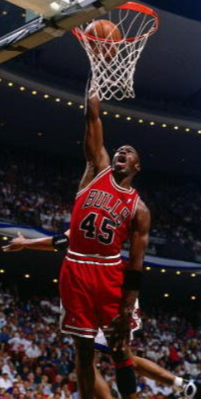

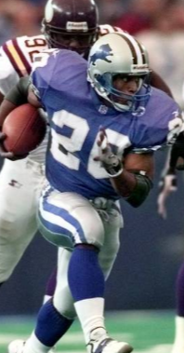
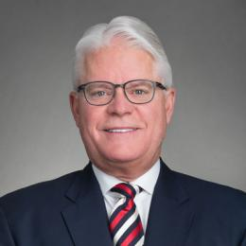

The 90’s
Notes:
The 90’s
The top artists of the 90’s were:
Nirvana – smells like teen spirit
R.E.M.
The top grossing movies were:
#1 Titanic
#3 Jurassic Park
The best athletes were
Michael Jordan
Andre Agassi
Barry Saunders
90’s – Cemented and Cementless fixation

Slide 12
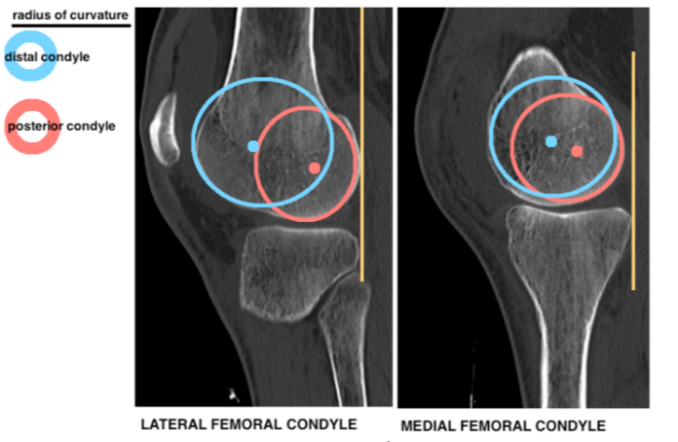
Lateral femoral condyle
  Variable Radius of curvature
  Flat in extension
  Curved in Flexion
Medial femoral condyle
  Constant Radius of curvature
  Curved in both extension and flexion

Slide 13
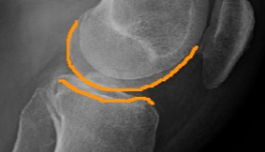
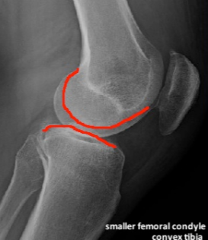
Convex lateral tibial plateau
Concave medial tibial plateau

Slide 14
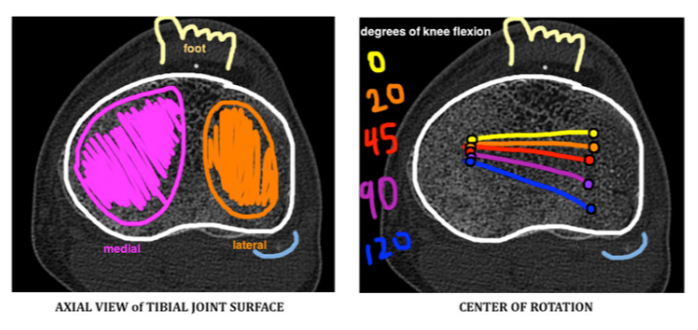
Lateral Condyle rolls back 12 to 21mm
Medial Condyle rolls back 2-3mm
External Rotation averages 16° to 23°
Notes:
MFC & MTP are about 20-30% larger than the lateral side

Slide 15
Larger Medial Compartment built for
  Stability
  Weight bearing / improved contact area
Smaller Lateral Compartment built for
  Roll back
  Range of motion

Slide 16
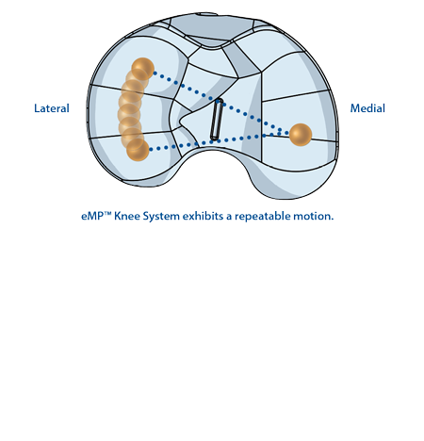
Knee replacement design with different roles for the medial and lateral compartments
Medial Pivot
Knee Replacement

Slide 17




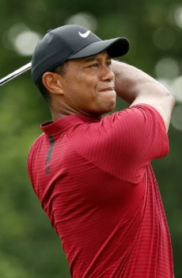

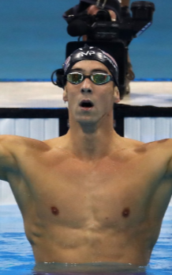
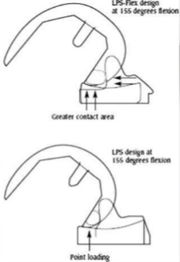
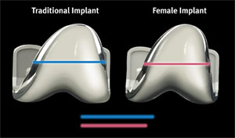
The 00’s
5
Notes:
The 00’s
The top artists of the 00’s were:
#2 Usher gave us – Yeah!
#4 Black Eye peas - I gotta a feeling
The top grossing movies were:
#1 – Avatar
#4 – Pirates of the Carribean -
The new millimium gave us great athletes with their own unique flaws:
Tiger,
Lance Armstrong,
Mchael Phelps
Kinematic Alignment – Otis Med
Otis Med was founded in 2005
Sold to Stryker in 2009 for $~103 million
FDA ordered them to stop and submit for clearance.
CEO sent out remaining PSI instruments.
Stryker shut it down in 2011
CEO went to jail for 2 years
Stryker fined $40 million by FDA and $40 million in civil suits.

Slide 18

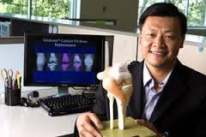
$27 Million
FDA ordered stop
Founded
2005
2007
2009
2011
2 yrs in jail
$80 million in fines
2006
2008
2010
Filed for FDA Clearance
Sold to Stryker
Stryker shut it down
Notes:
Otis Med is the Orthopedic version of Thernanos
It was founded in 2005
sold $27 mill in products in 3 years
failed to obtain FDA clearance for the first 2 ½ years
Sold to Stryker in 2009 for $~103 million
FDA ordered them to stop and submit for clearance.
CEO sent out remaining PSI instruments.
Stryker shut it down in 2011
CEO, Charlie Chi, went to jail for 2 years
Stryker fined $80 million ($40 million by FDA and $40 million in civil suits.

Slide 19
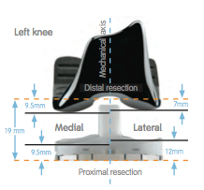
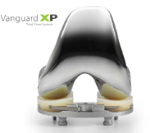

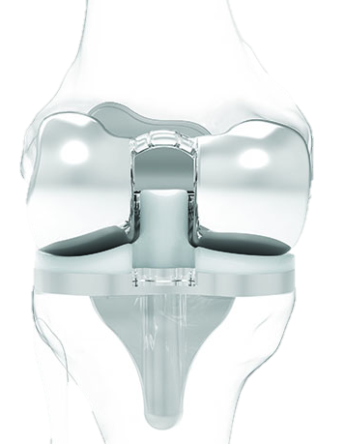
The 10’s
5
Notes:
The 00’s
The top artists of the 00’s were:
#2 Usher gave us – Yeah!
#4 Black Eye peas - I gotta a feeling
The top grossing movies were:
#1 – Avatar
#4 – Pirates of the Carribean -
The new millimium gave us great athletes with their own unique flaws:
Tiger,
Lance Armstrong,
Mchael Phelps
Kinematic Alignment – Otis Med
Otis Med was founded in 2005
Sold to Stryker in 2009 for $~103 million
FDA ordered them to stop and submit for clearance.
CEO sent out remaining PSI instruments.
Stryker shut it down in 2011
CEO went to jail for 2 years
Stryker fined $40 million by FDA and $40 million in civil suits.

Slide 20
Options to recreating the Varus joint line in TKAs
3 options:
Ignore the Varus Joint Line
Bone cuts perpendicular to MA
External rotate femoral component
Make varus tibial cut
valgus femoral cut
Use Implants with differential poly thickness.

Slide 21
Just ignore the varus joint line
Classical Alignment
Varus Cuts
Kinematic Alignment
Varus Implants

Slide 22
When there is no varus joint line
No need to use a varus implant
No need to make varus bone cuts
No need to external rotate the femur
2/3 of TKAs have a varus joint line.
When the surgeon ignores it,
  They must external rotate the femoral component
  Abnormal Kinematics

Slide 23
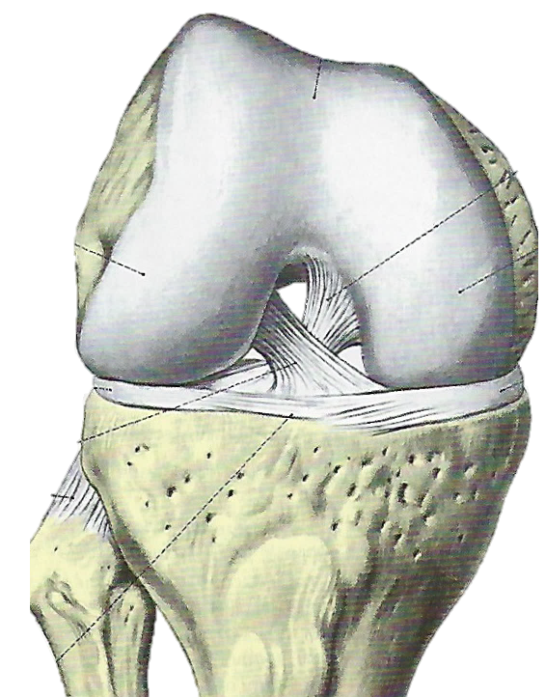
Why do we external rotate the femoral component
Perpendicular tibial cut
10 mm off the lateral side
2 mm off the medical side
Must externally rotate femur to balance flexion gap.
Extension
Flexion

Slide 24
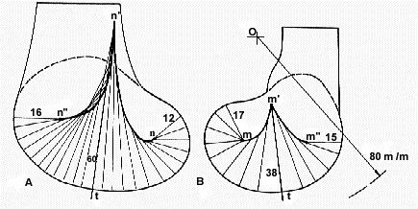
External Rotation changes the role of the MFC & LFC
MFC
LFC
Notes:
MFC is bigger and designed for load bearing and stability– distributing weight across the joint
LFC is smaller and designed for axial rotation, ROM and patellar mechanics.
Ignoring the varus joint line basically makes the LFC = the MFC in size which decreases axial rotation and limits flexion.

Slide 25
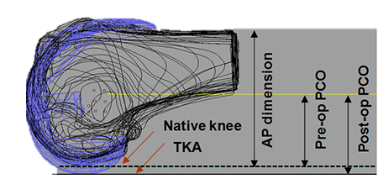
External Rotation decreases posterior offset on the MFC
Bellemans, et. at. 2001
Decreased posterior condylar offset causes decreased flexion

Slide 26
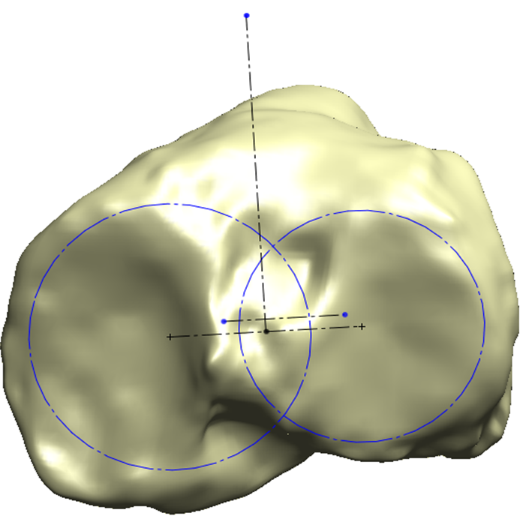
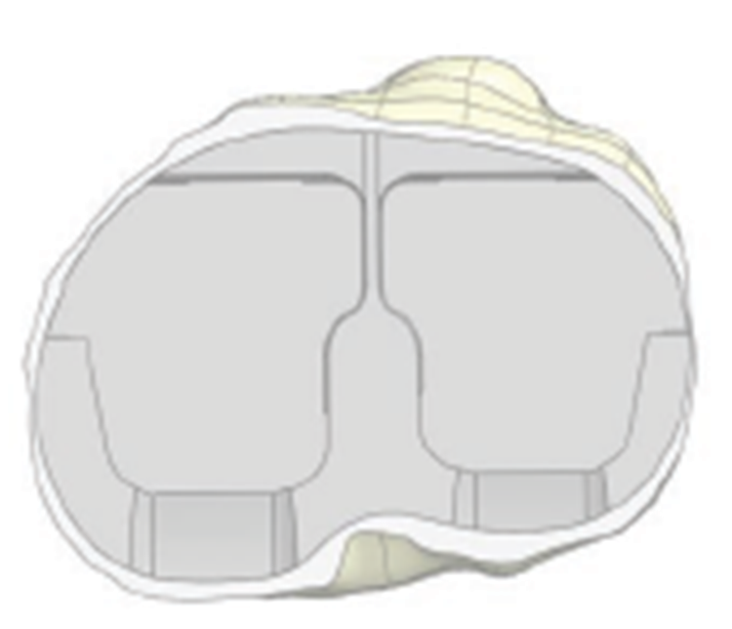
Femoral External Rotation causes Paradoxical Motion
Normal Motion
Paradoxical Motion
Tibia clears Femur & Normal Wt Bearing Flexion
Tibia Impinges on Femur & decreases Wt Bearing Flexion
Femoral external rotation causes external rotation in extension

Slide 27
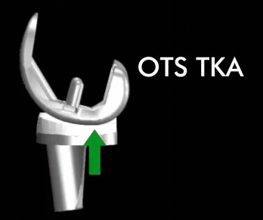
Frequency of Paradoxical Motion
Dennis, et al (2003)

Slide 28
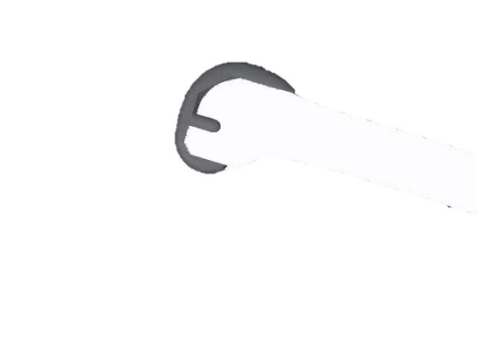
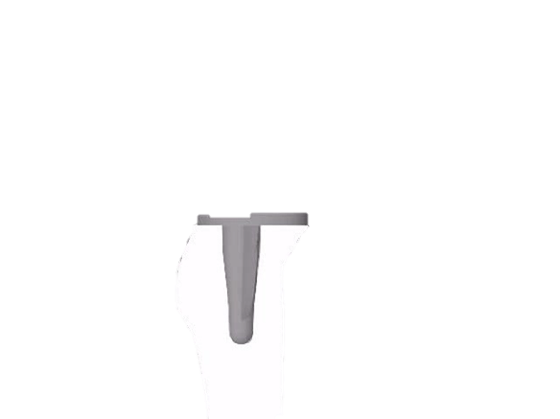
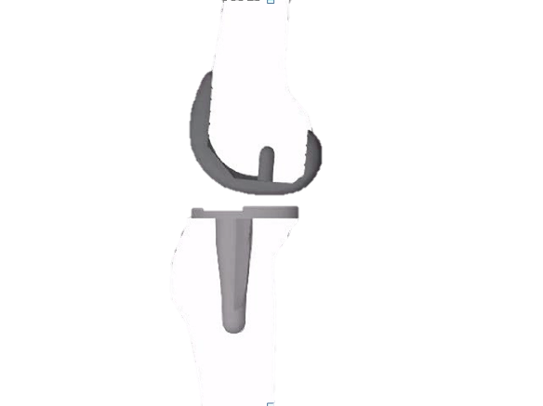
Decreased condylar offset creates posterior impingement
Paradoxical motion creates posterior impingement
Posterior impingement limits flexion
Posterior Impingement

Slide 29
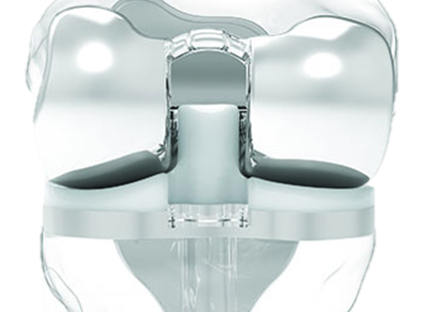

Kinematics

Slide 30
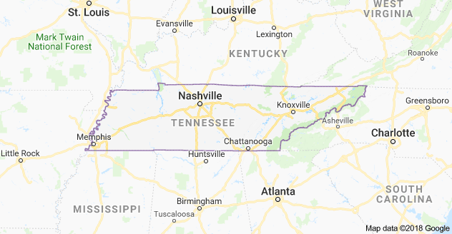

Komistek Study
 | CR | PS
Conformis | 24 patients | 14 patients
OTS | 14 patients | 18 patients
Notes:
70 of my patients drove over to Knoxville

Slide 31

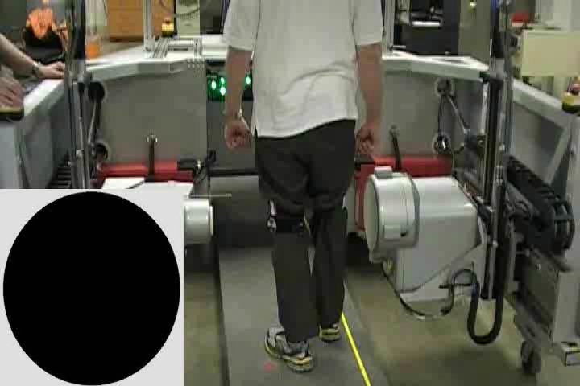
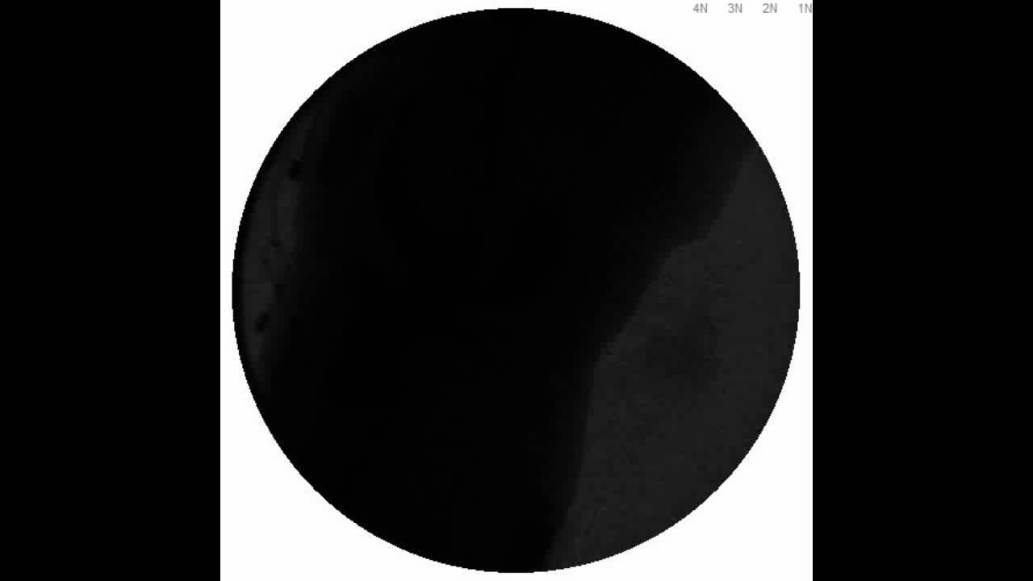
Mobile Fluoroscopy
Tracking Fluoroscopic System

Slide 32
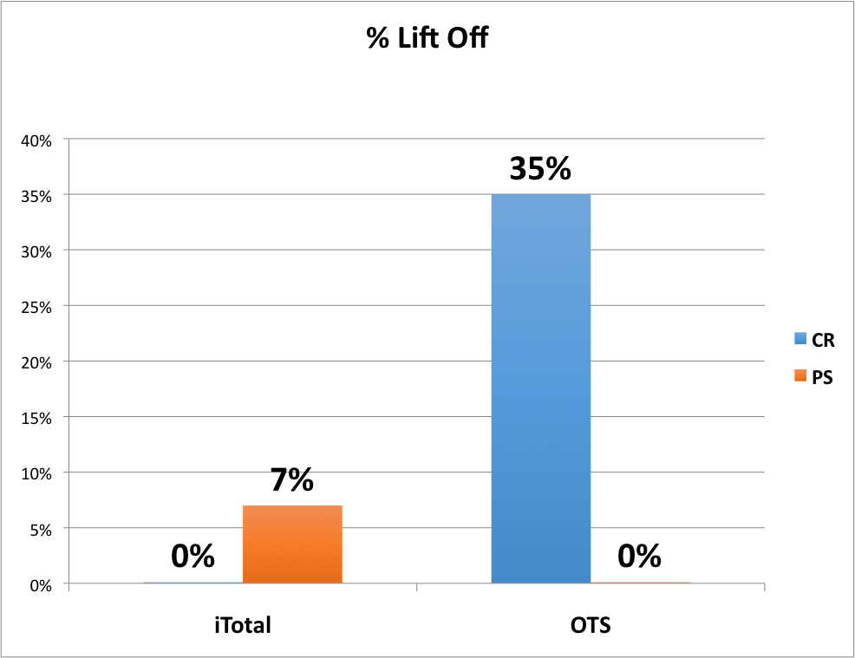
Lift Off

Slide 33
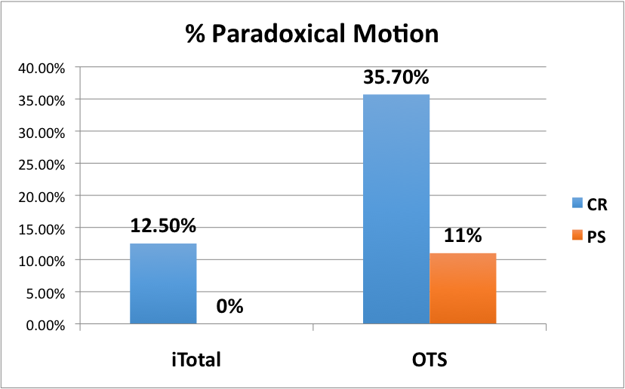
Paradoxical Motion
Notes:
3 out of 24 CR itotal’s had paradoxical motion (12.5%) compared to 5 out of 14 CR NexGen (36%)
No PS Itotal had paradoxical motion and 2 out of 18 PS Nexgen had paradoxical Motion.

Slide 34
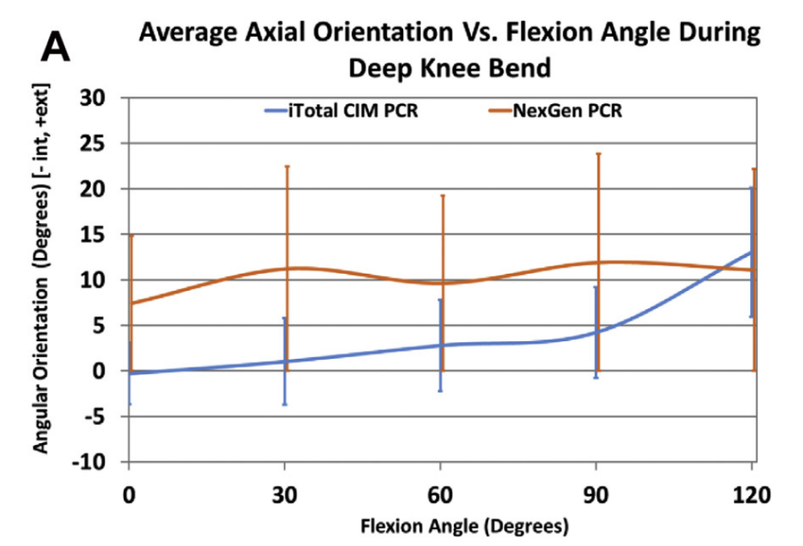
CR Results: Axial Rotation

Slide 35
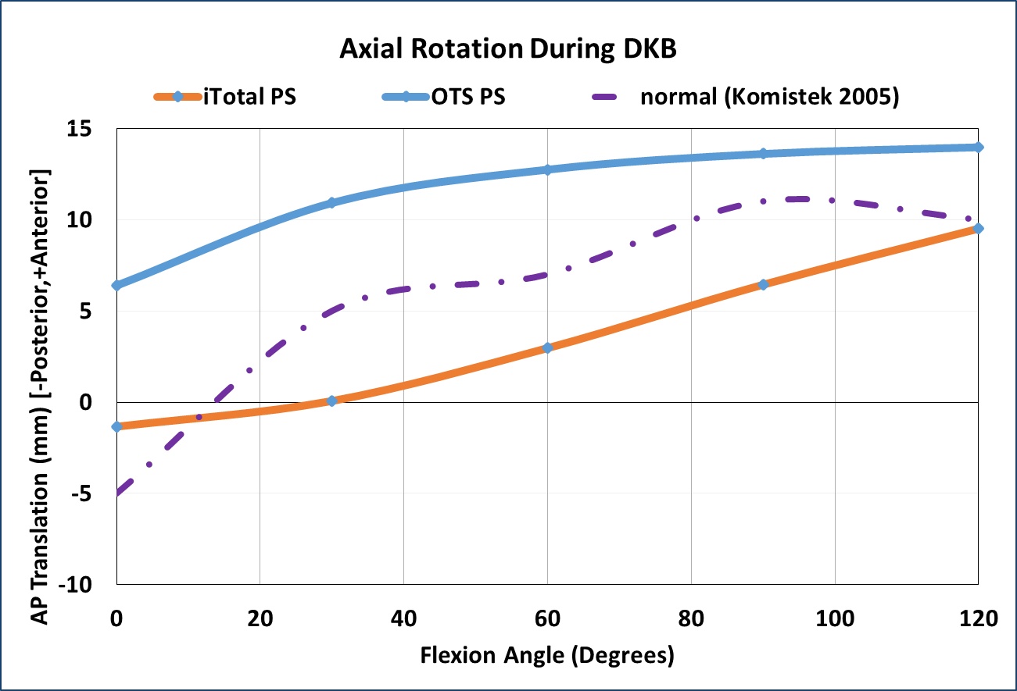
PS Results: Axial Rotation

Slide 36
Paradoxical Motion vs. Normal Axial Rotation
Flexion
 | Paradoxical Motion CR | Normal Axial Rotation CR | Paradoxical Motion PS | Normal Axial Rotation PS
Wt bearing Flexion | 96.6° | 105° | 94° | 103°
Difference | 8° |  | 9°
Notes:
Kneees that have paradoxical motion have 8-9 degrees of less weight bearing flexion

Slide 37
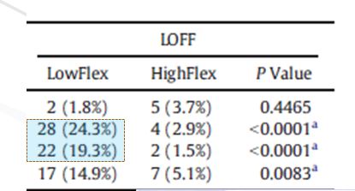
Abnormal Knee Kinematics:
Lift-off decreases weight bearing flexion
  Sharma, Dennis et al 2014 >400 patients
    43% with poor wt bearing flexion had lift off
    Only 6% with good wt bearing flexion had lift-off
  2014 Paper

Slide 38
Weight bearing vs. non-weight bearing
Flexion
 | OTS CR | Itotal CR | OTS PS | Itotal PS
Non-Wt bearing Flexion | 116° | 119° | 120° | 117°
Wt Bearing Flexion | 96° | 104° | 94° | 113°
Difference | 20° | 15° | 26° | 4°
Notes:
Large difference in weight bearing vs. non-weight bearing flexion, especially with OTS implants

Slide 39
Lessons Learned
External Femoral Rotation leads to
  Decreased posterior condylar offset
  Paradoxical motion
Posterior impingement
Decreased weight bearing flexion
Conformis knees had
  More normal knee kinematics
    Less Lift off
    Less Paradoxical motion
  Increased in weight bearing flexion

Slide 40
Thanks
Will Kurtz, M.D.
kurtzwb@toa.com
https://drive.google.com/open?id=1e2Aj-7Hs_nXNjdxdv0AnYk0s2Noz4Y4W

